Slide 1
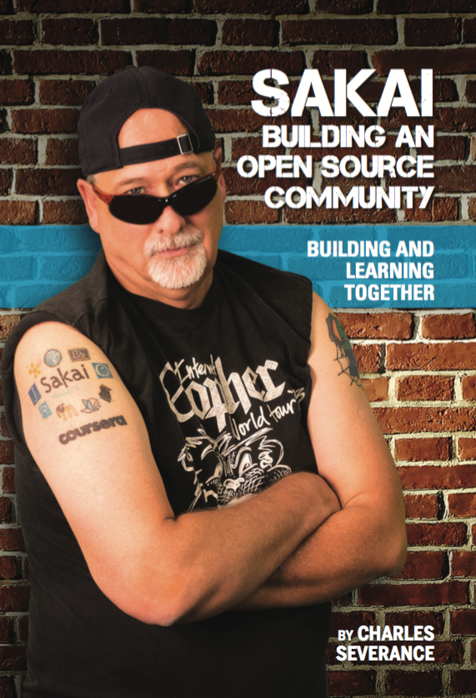
Dr. Chuck’s Big Adventure: Sakai’s Past, Present, and Future
Dr. Charles Severance
Sakai PMC Chair

Slide 2
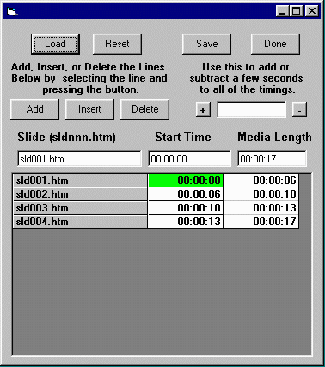
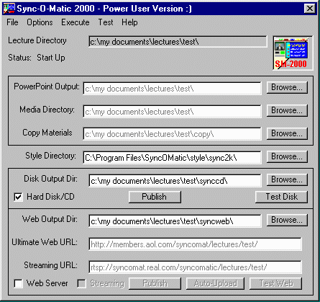
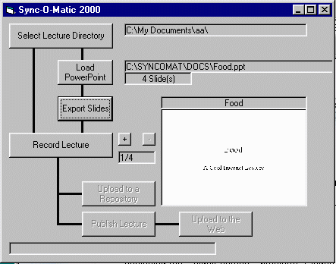
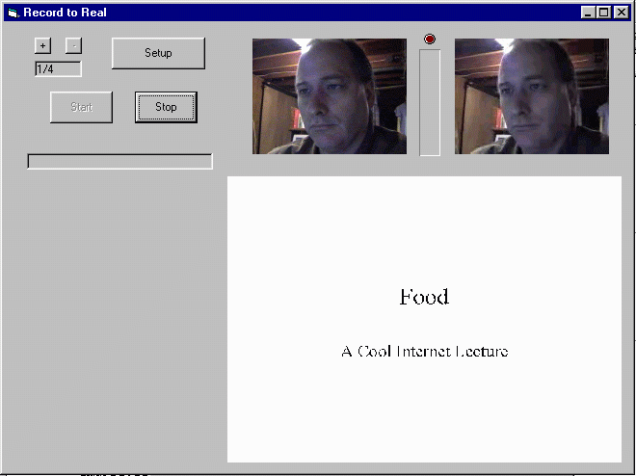
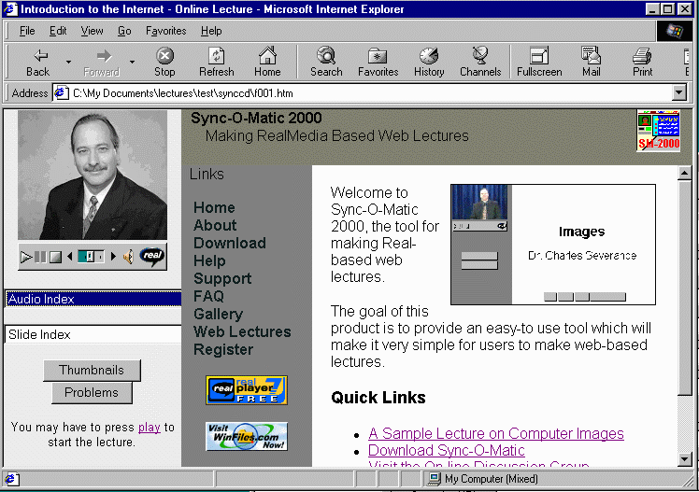
1998

Slide 3
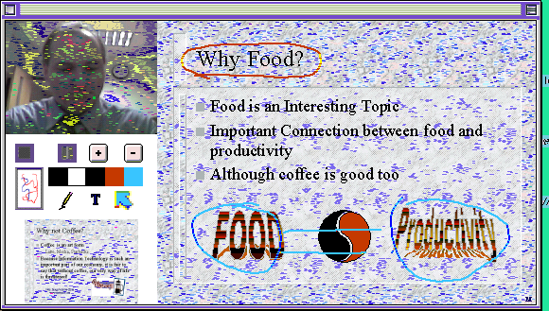
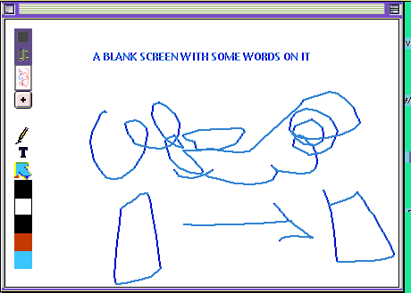
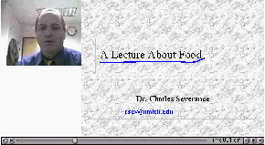
2001

Slide 4
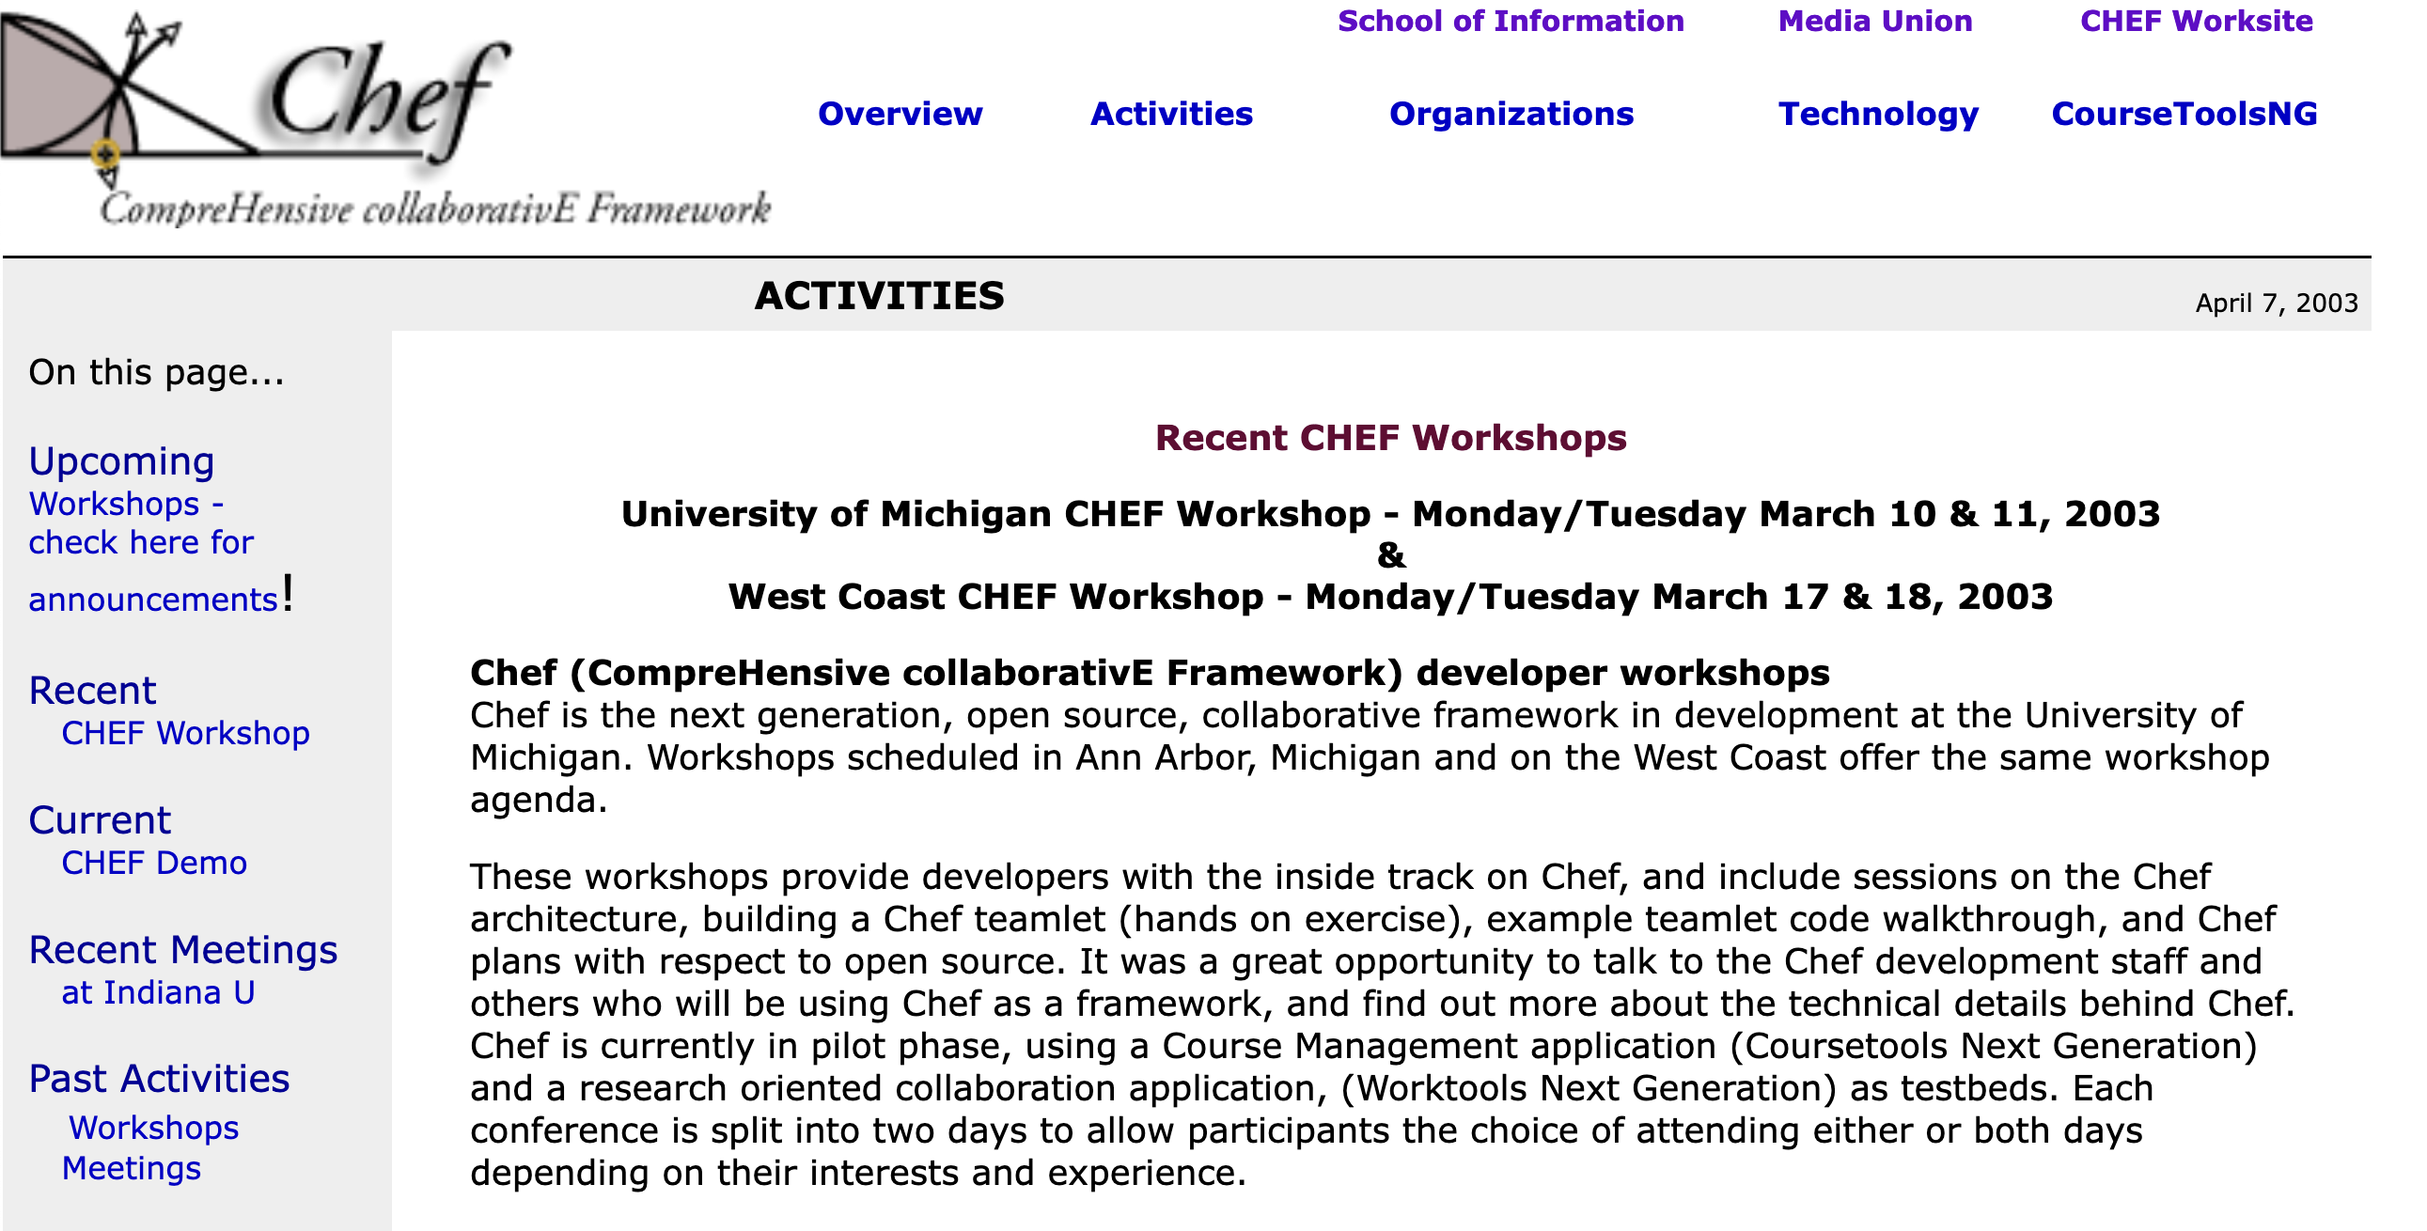
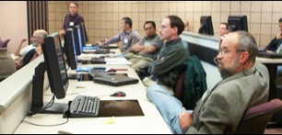
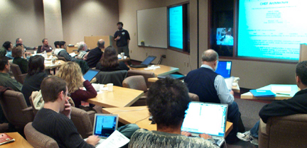
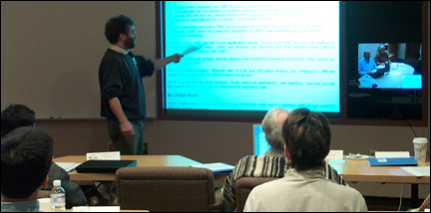
2003

Slide 5
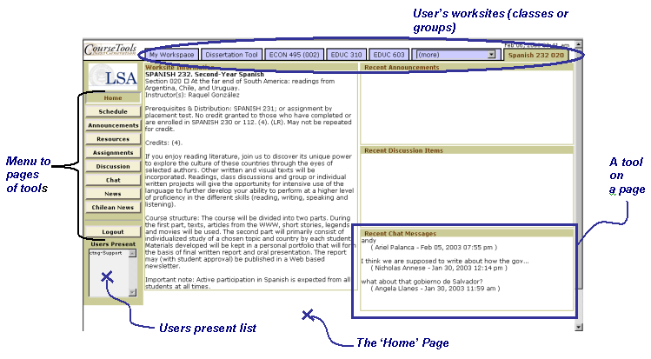

Slide 6
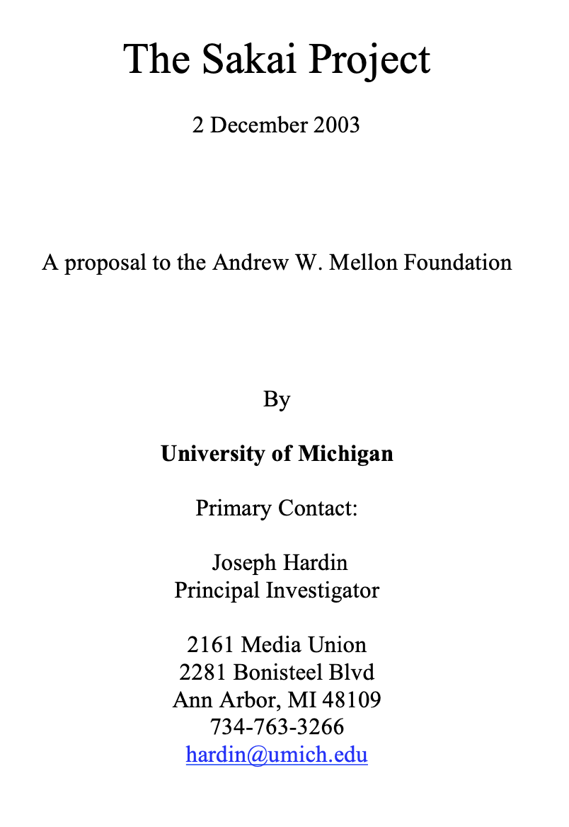
The products of this project will include an Enterprise Services-based Portal, a complete Course Management System with sophisticated assessment tools, a Research Support Collaboration System, a Workflow Engine, and a Tool Portability Profile, i.e., clear standard for writing future tools that can extend this core set of educational applications. ... This effort will demonstrate the compelling economics of “software code mobility” for higher education, and it will provide a clear roadmap for others to follow.

Slide 7
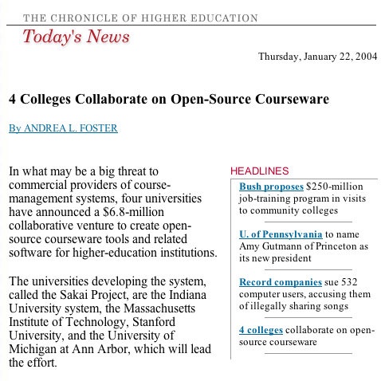

Slide 8
2004 Was a Blur…
Getting to know each other
Interest from around the world – lots of travel / recruitment
Where is the grade book?
Can you impersonate a user?
Is there any way to organize content other than files (like modules)?
JSF? Velocity? Hibernate? Spring?
This stores everything in memory and XML??? WTH??

Slide 9
At the end of 2004
We had out first IMS Tools Interoperability demo scheduled
We released our 1.0 version "on schedule" – it was not fit for production at all
University of Lleida ran it in production Fall 2004 and loved it! (*)
All we knew was that we needed a version 2.0 ASAP!
Jetspeed -> Our own portal and augmented servlet
We needed to switch to a database
And we needed to build new core features during the major upheaval of Sakai 1.0 to Sakai 2.0

Slide 10
The first half of 2005..
Sakai 2.0 was released in June 2005 just in time for our Baltimore Conference
It was an amazing rewrite – at some cost of organizational unity
The conference was *packed* - tons of interest
There was a session about a contrib tool called "Lessons" from Chuck Hedrick of Rutgers University

Slide 11
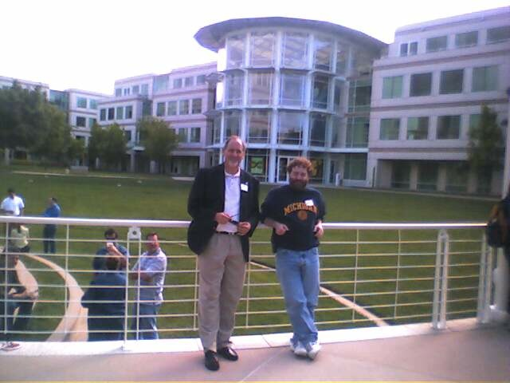
April 27, 2005

Slide 12
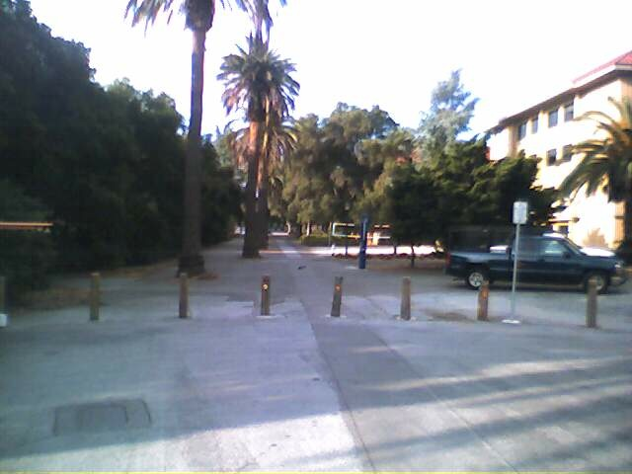
April 29, 2005

Slide 13
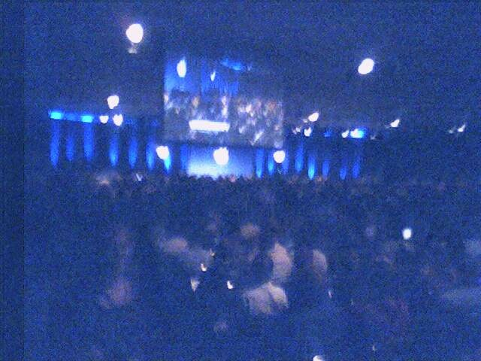
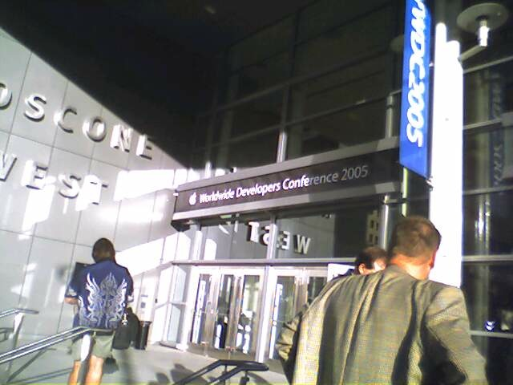
April 27, 2005

Slide 14
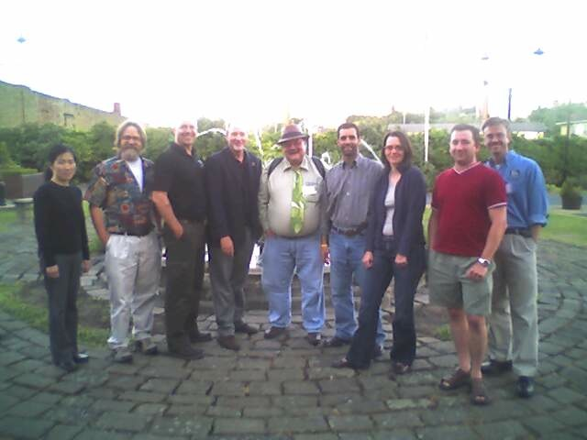
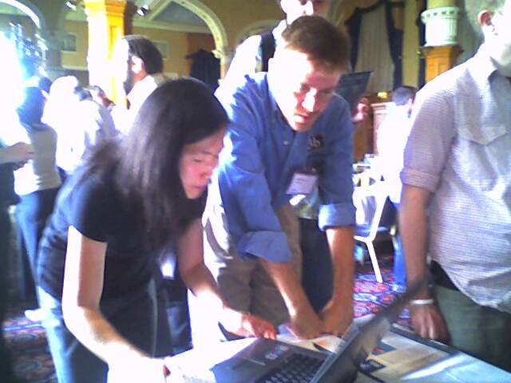
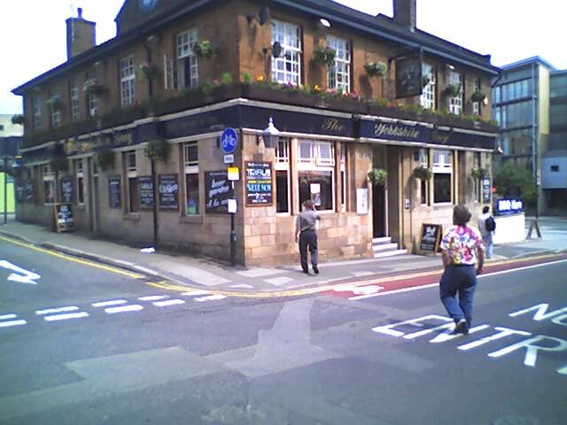
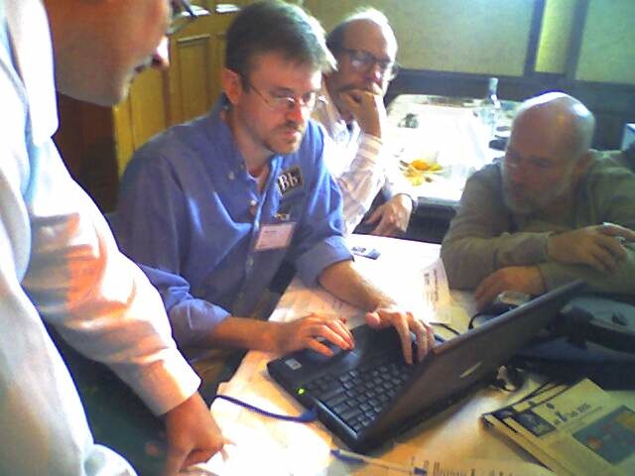
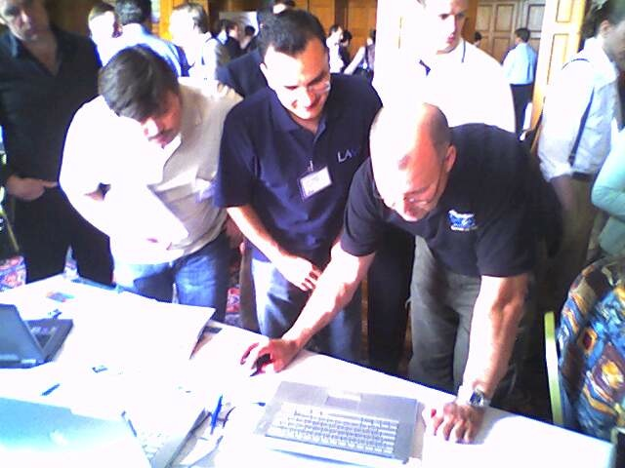
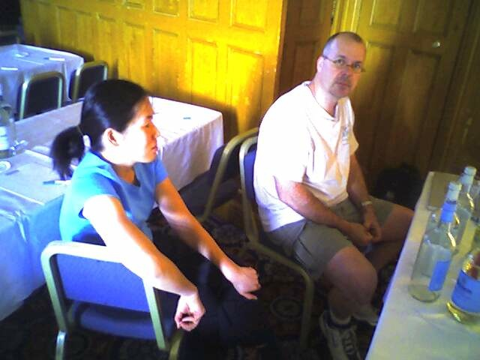
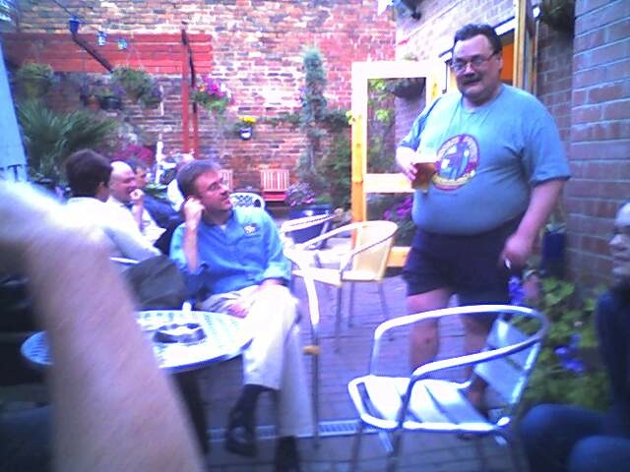
June 2005

Slide 15
End of 2005
Sakai Project ends and Sakai Foundation begins
Sakai 2.1 released in December
Cleaned up outstanding 2.0 issues
Tools started arriving
Schools could run Sakai 2.1 and be pretty happy
The founding schools were tired and a bit frayed
We had 120 members and a solid revenue stream
The community was well beyond the four founding
The New Orleans conference in December was pretty fun!

Slide 16
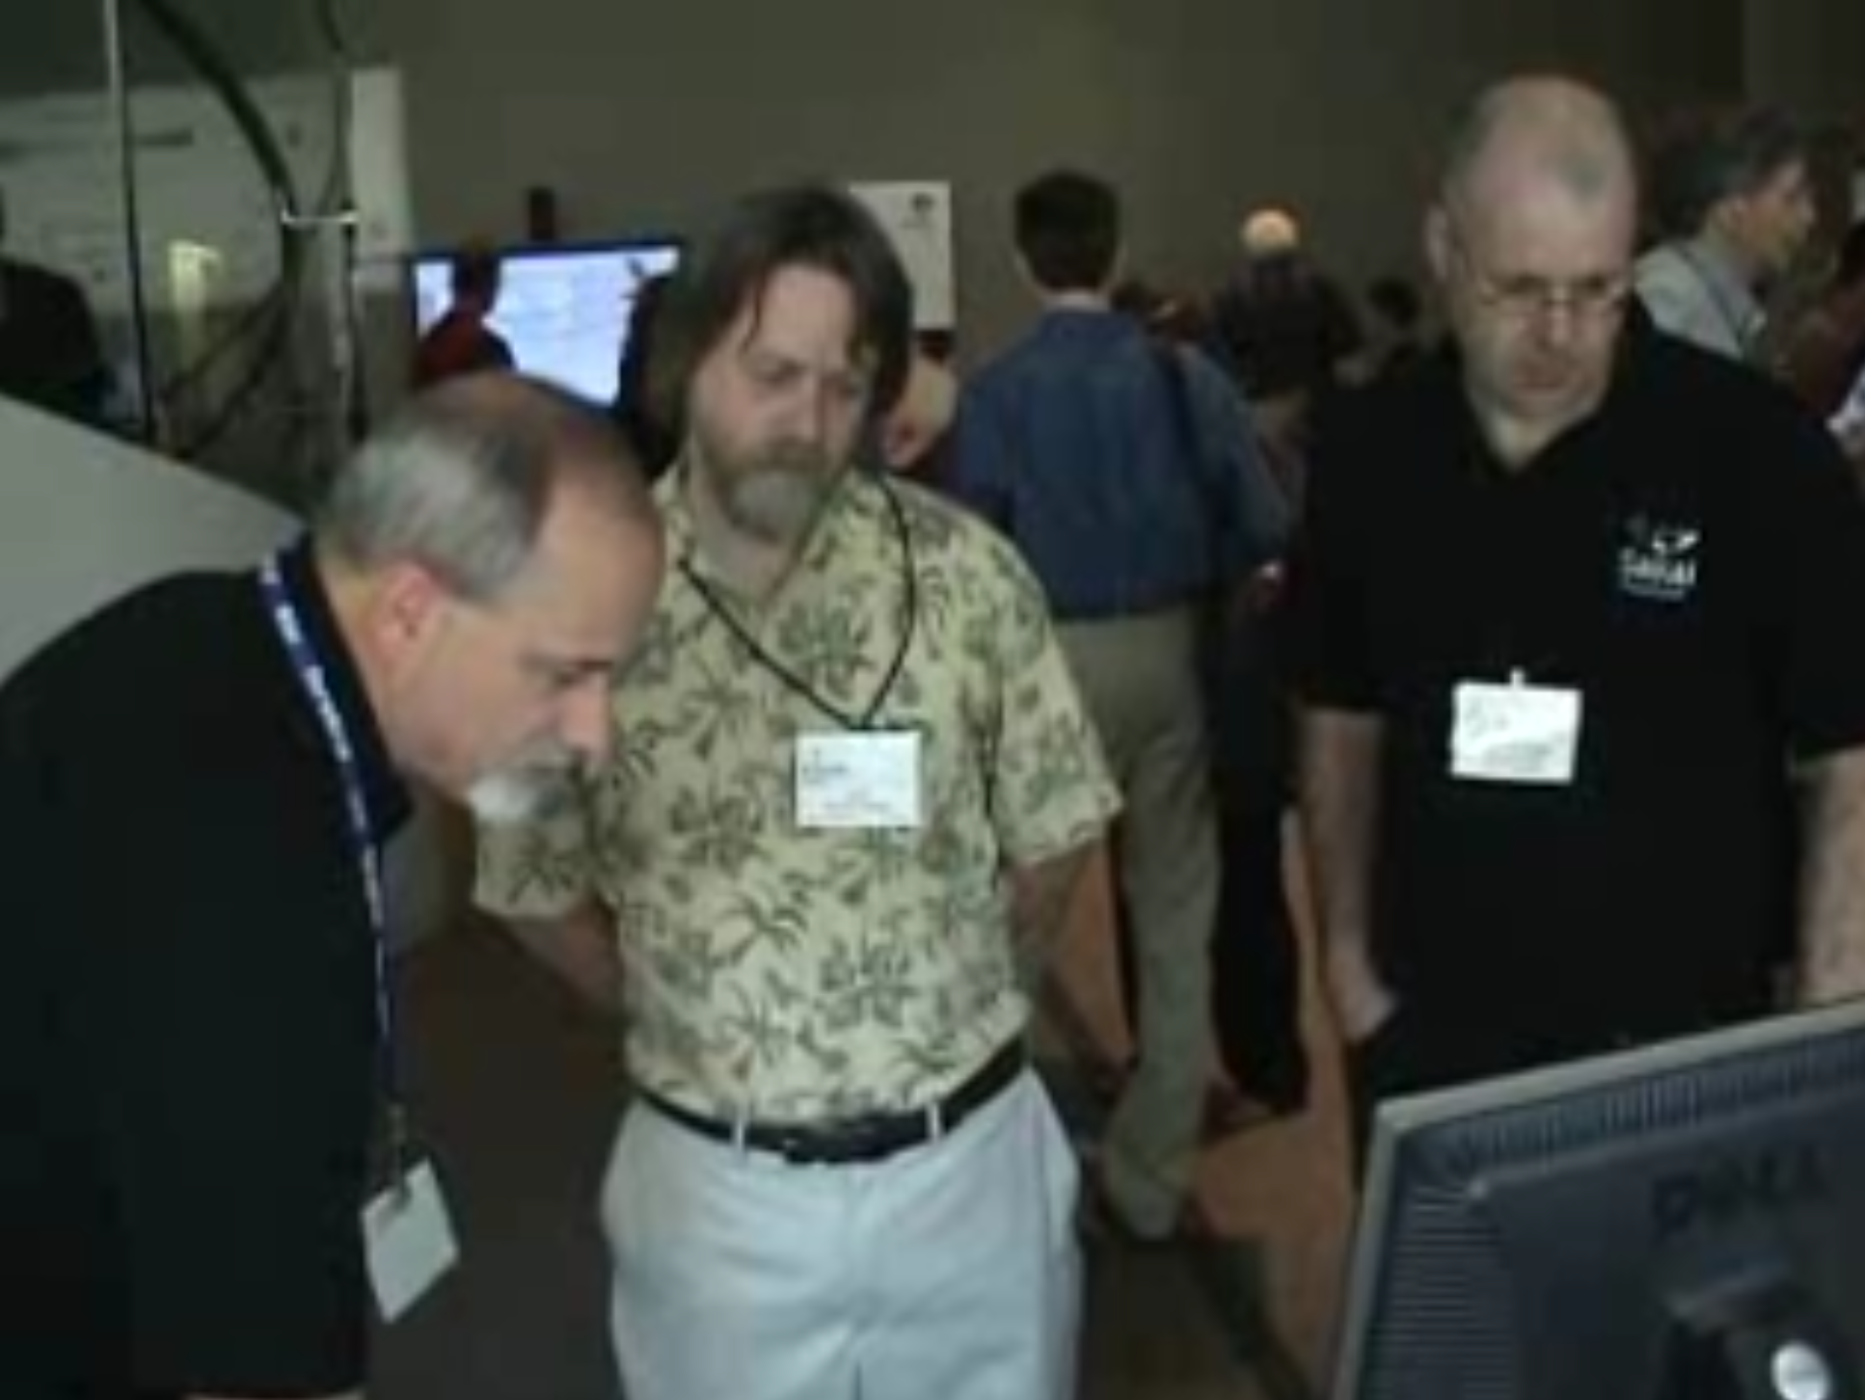
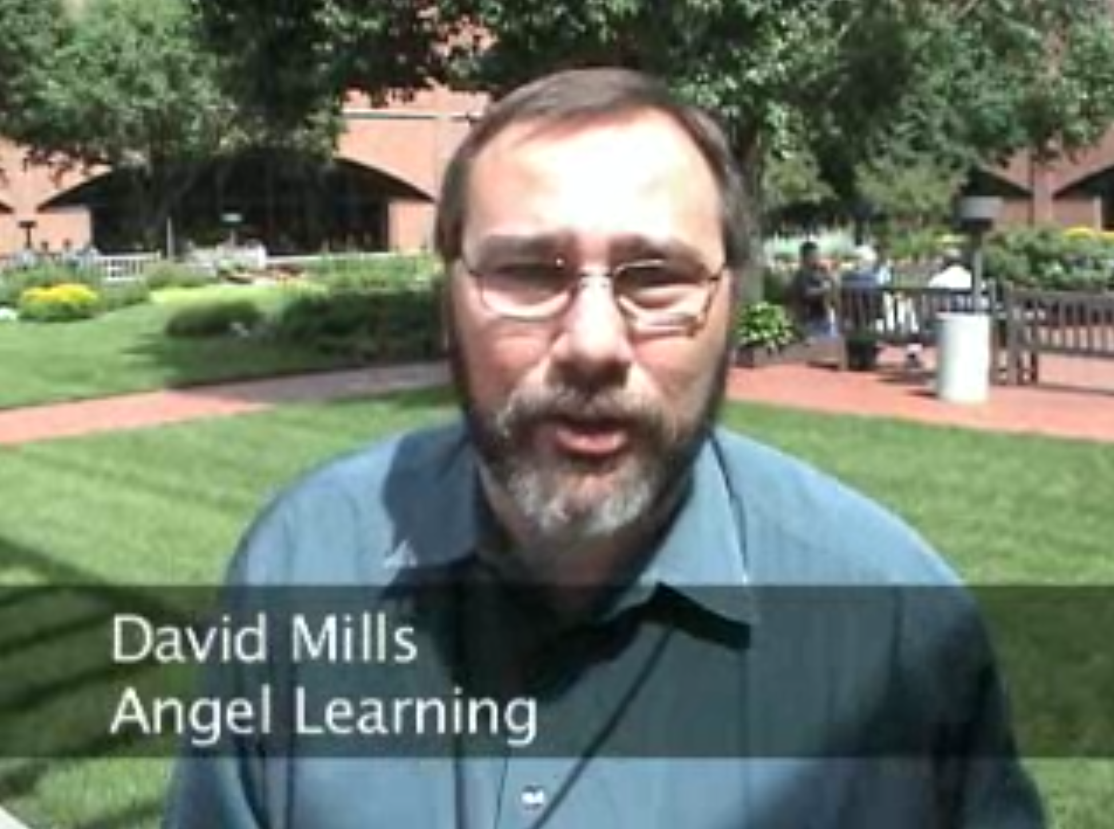

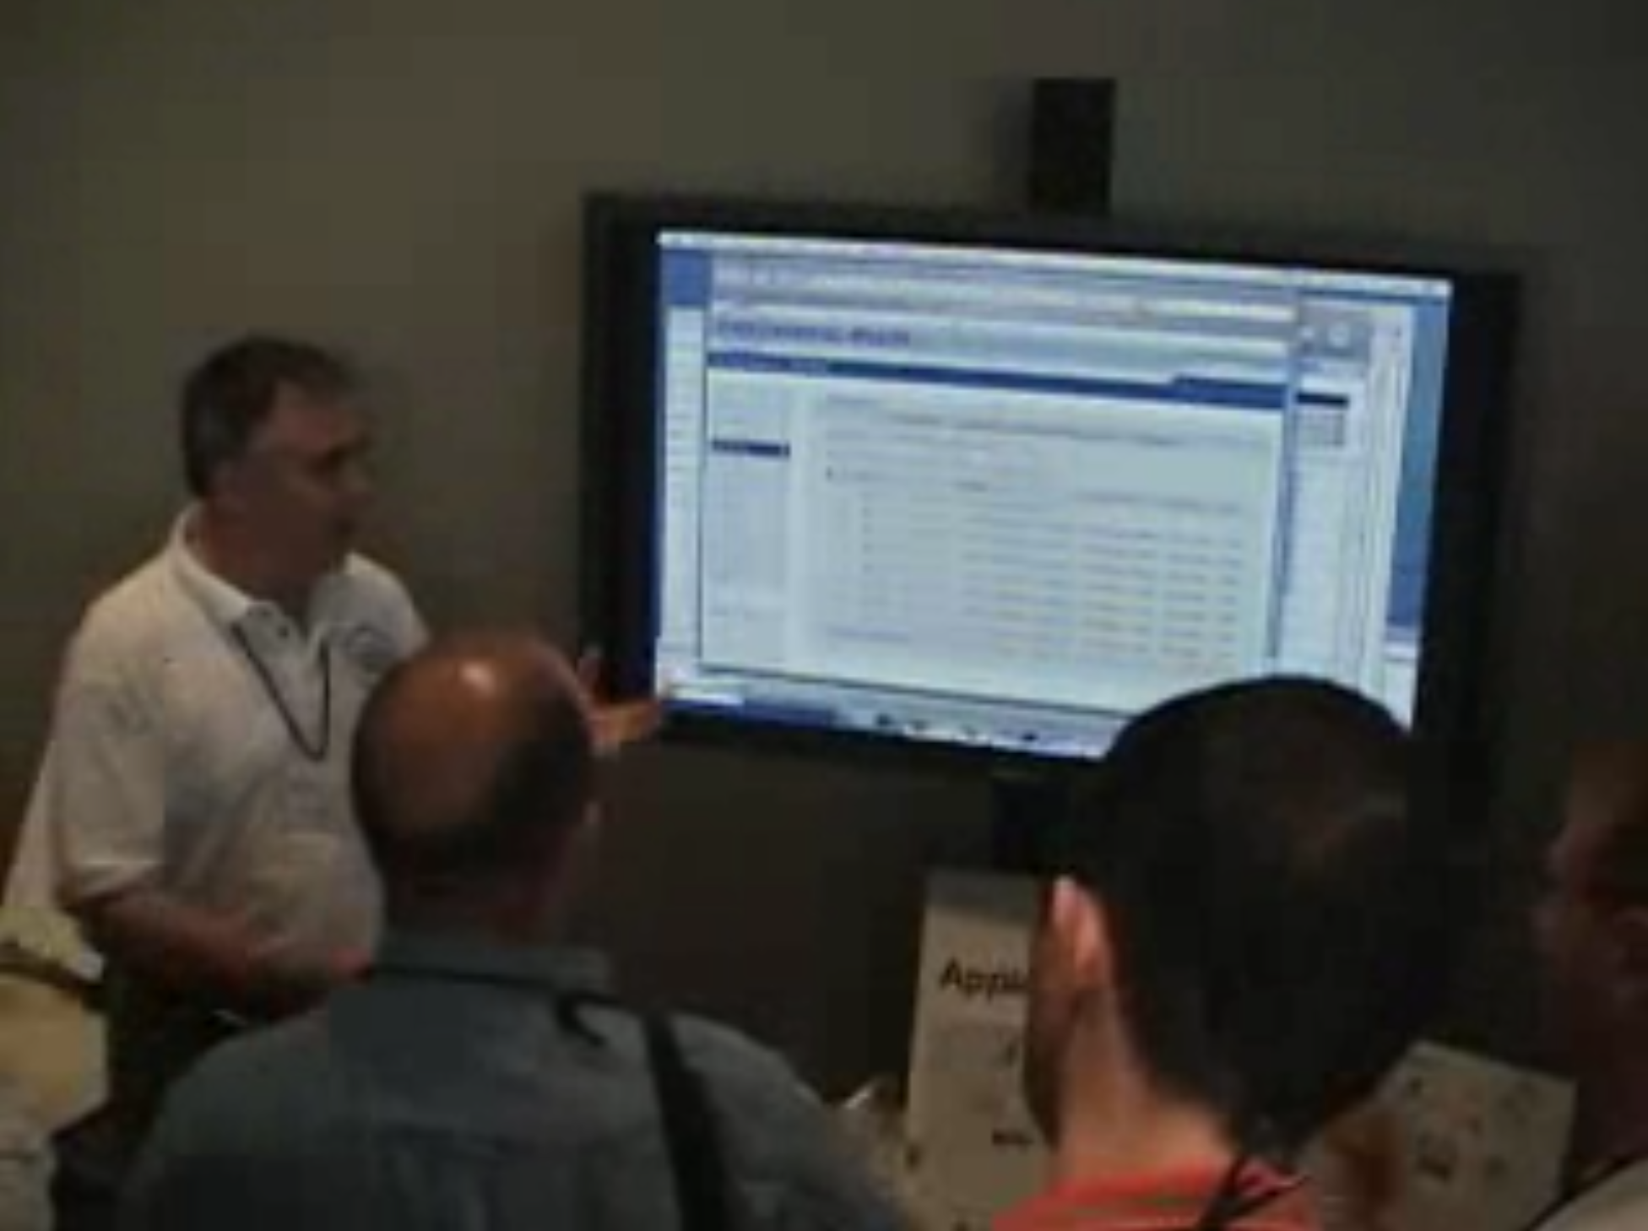
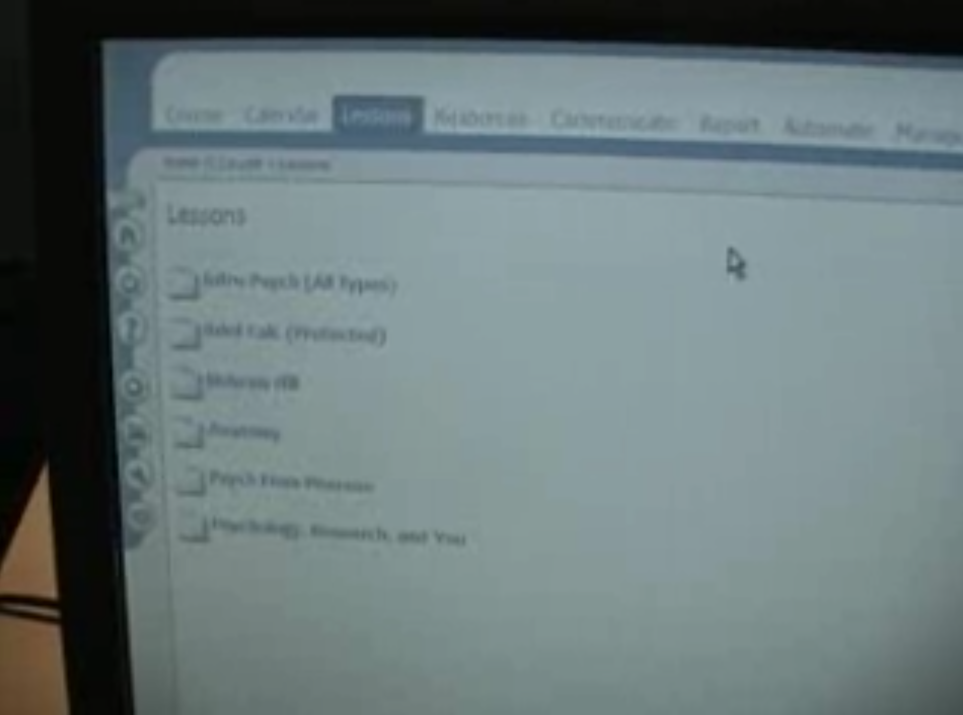
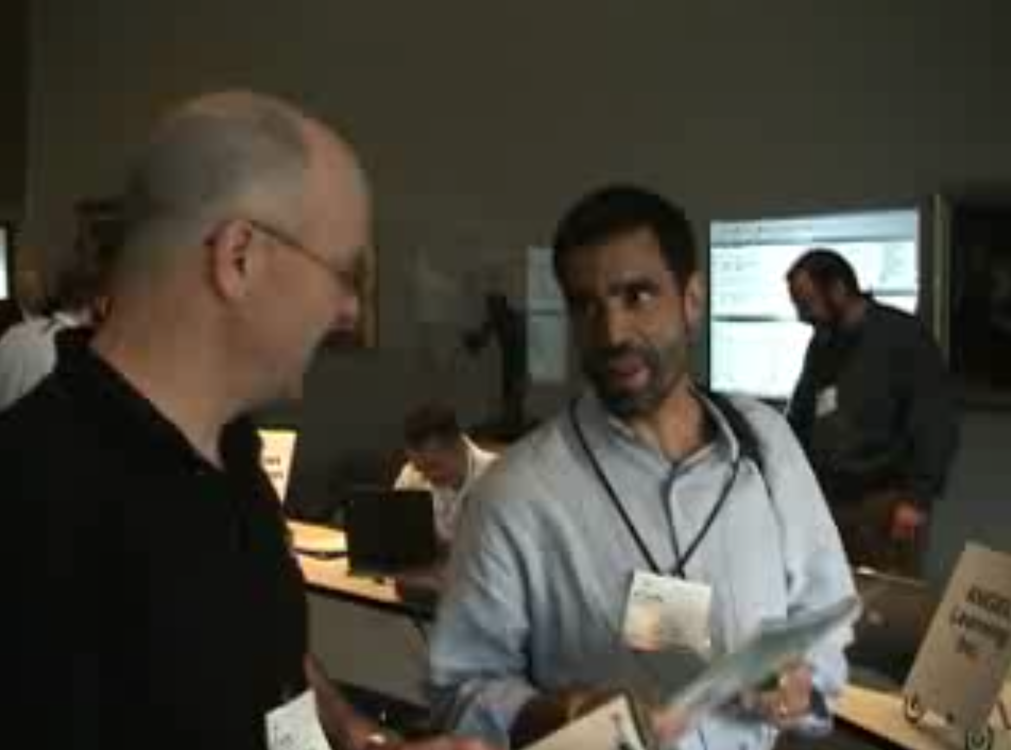
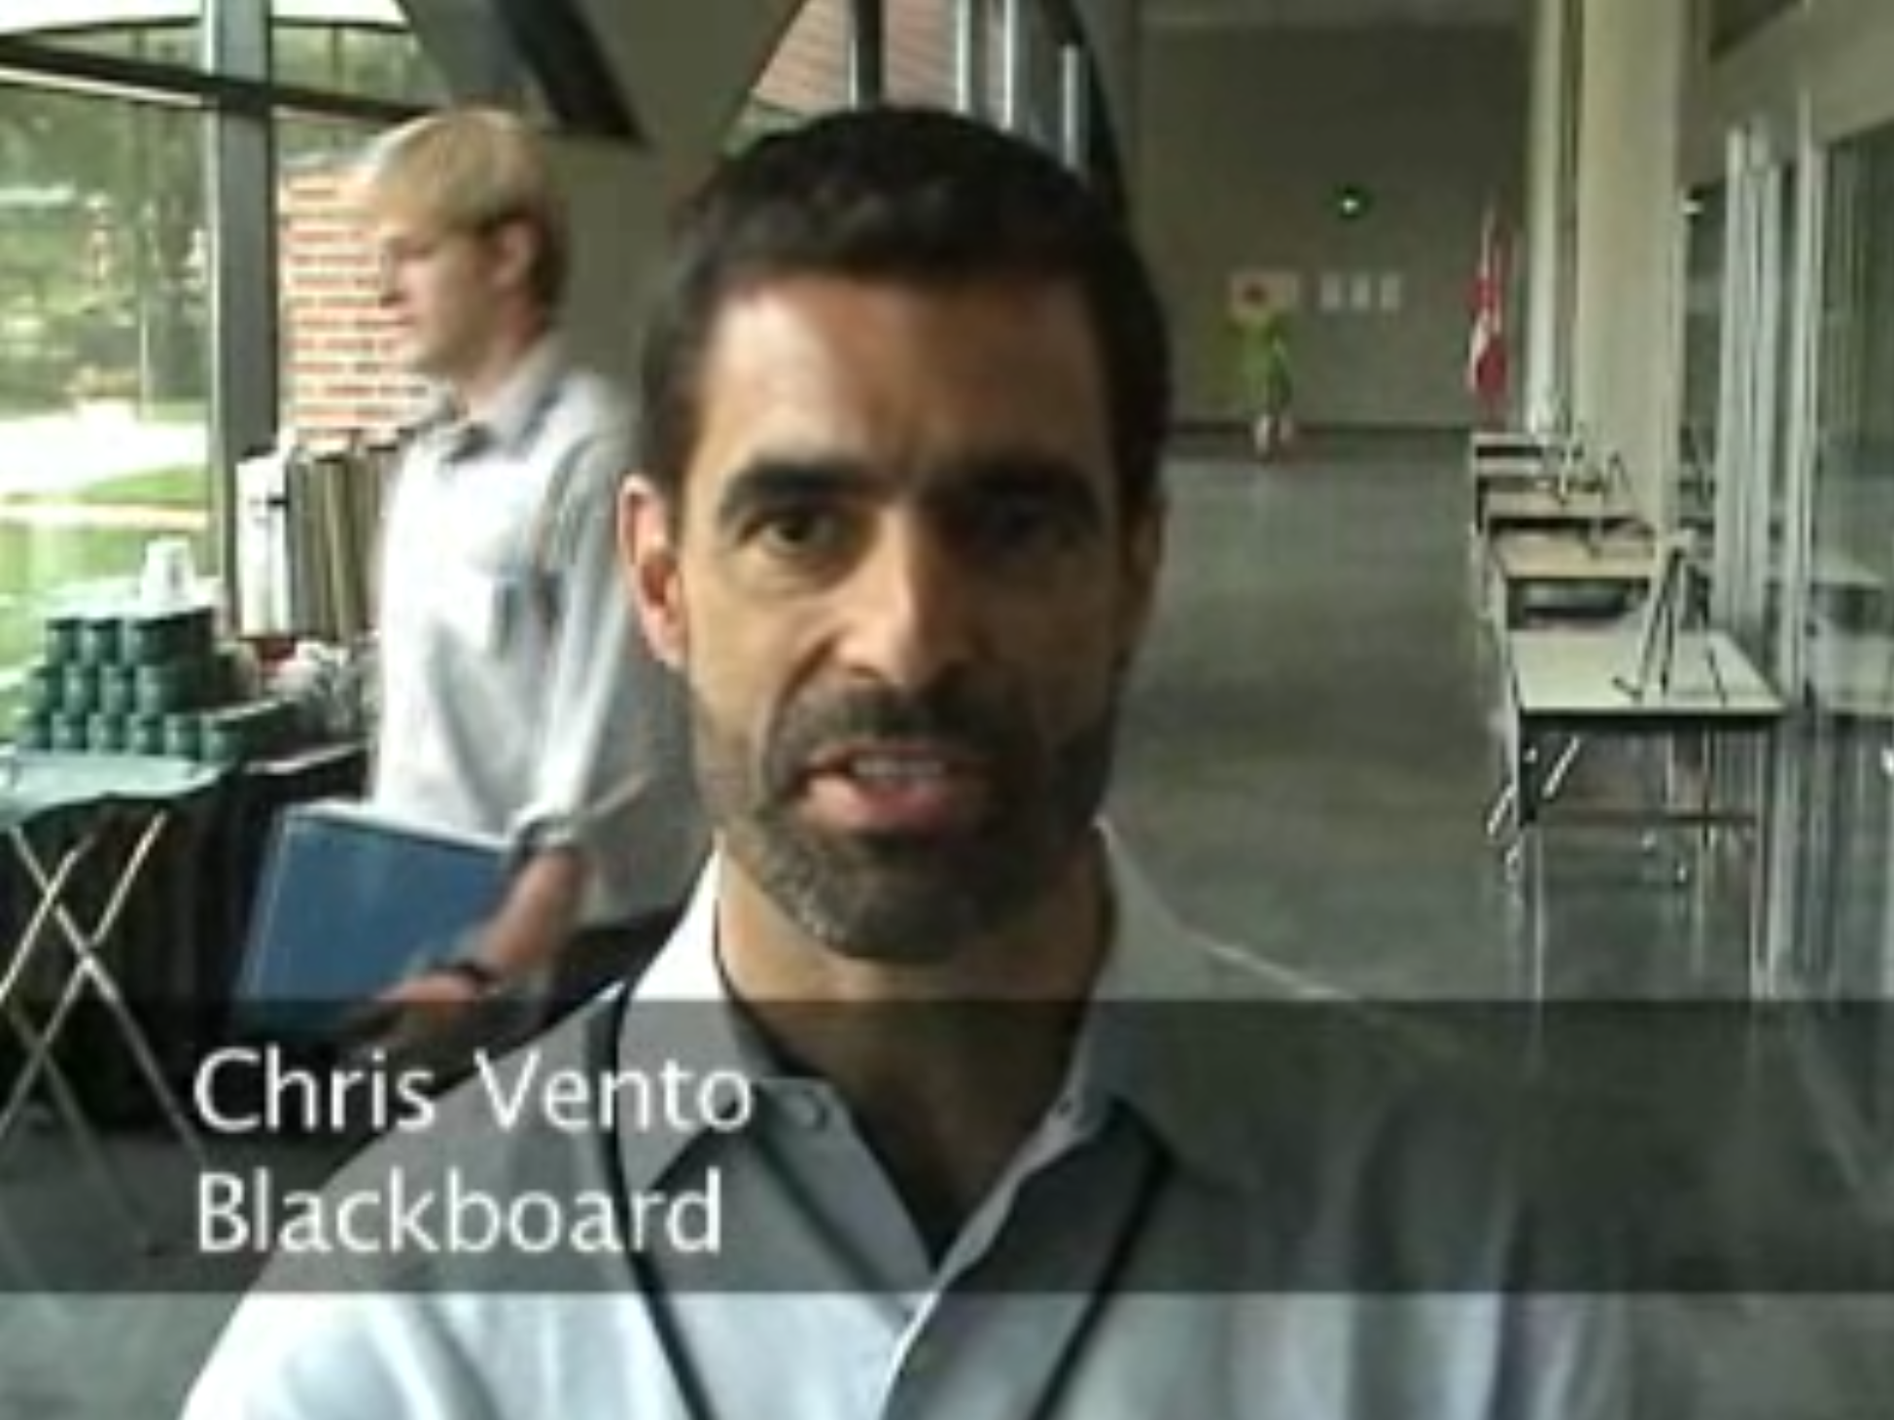
June 2006

Slide 17
At the End of 2006 (Sakai Foundation)
200 Schools and growing
Over $1 million in the bank
Tools Interoperability Founded
Common Cartridge Founded
Sakai 2.2 and 2.3 were released
Modules is widely used
Lessons emerging in contrib
Things are pretty awesome – we are a juggernaught

Slide 18
Sakai has unlocked an amazing future for educational technology
Many folks are excited…

Slide 19

The Dark Side of 2006
The newly created Sakai Foundation Board had $1M in the bank and wanted their executive director to spend it
The Executive Director wanted to keep the $1M as reserve and build up more money while letting the community solidify the gains made in Sakai 2.2 and 2.3
By December, I was ready to pull an "Obi-Wan Kenobi"

Slide 20
2007 Changing of the Guard
I resigned in March
The board replaced me with Michael Korkuska and he took over at the Summer 2007 Sakai conference in Amsterdam
I started as a faculty member in the University of Michigan School of Information in fall 2007
I taught Ruby on Rails to graduate students
Learning Tools Interoperability was my research area

Slide 21
2008
The board decided to spend their reserves, and hire a team to rewrite Sakai and call it Sakai 3.0 (a.k.a. 3akai)
They hired a professional project manager and announced it would be done June 2009
They said that "Sakai 2 would get no more investment" and that the Sakai 2 adopters should start paying for and contributing to Sakai 2
Also, two graduate students in Utah started writing an LMS based on Sakai 2.4, Common Cartridge, and LTI – they wrote it in Ruby on Rails

Slide 22
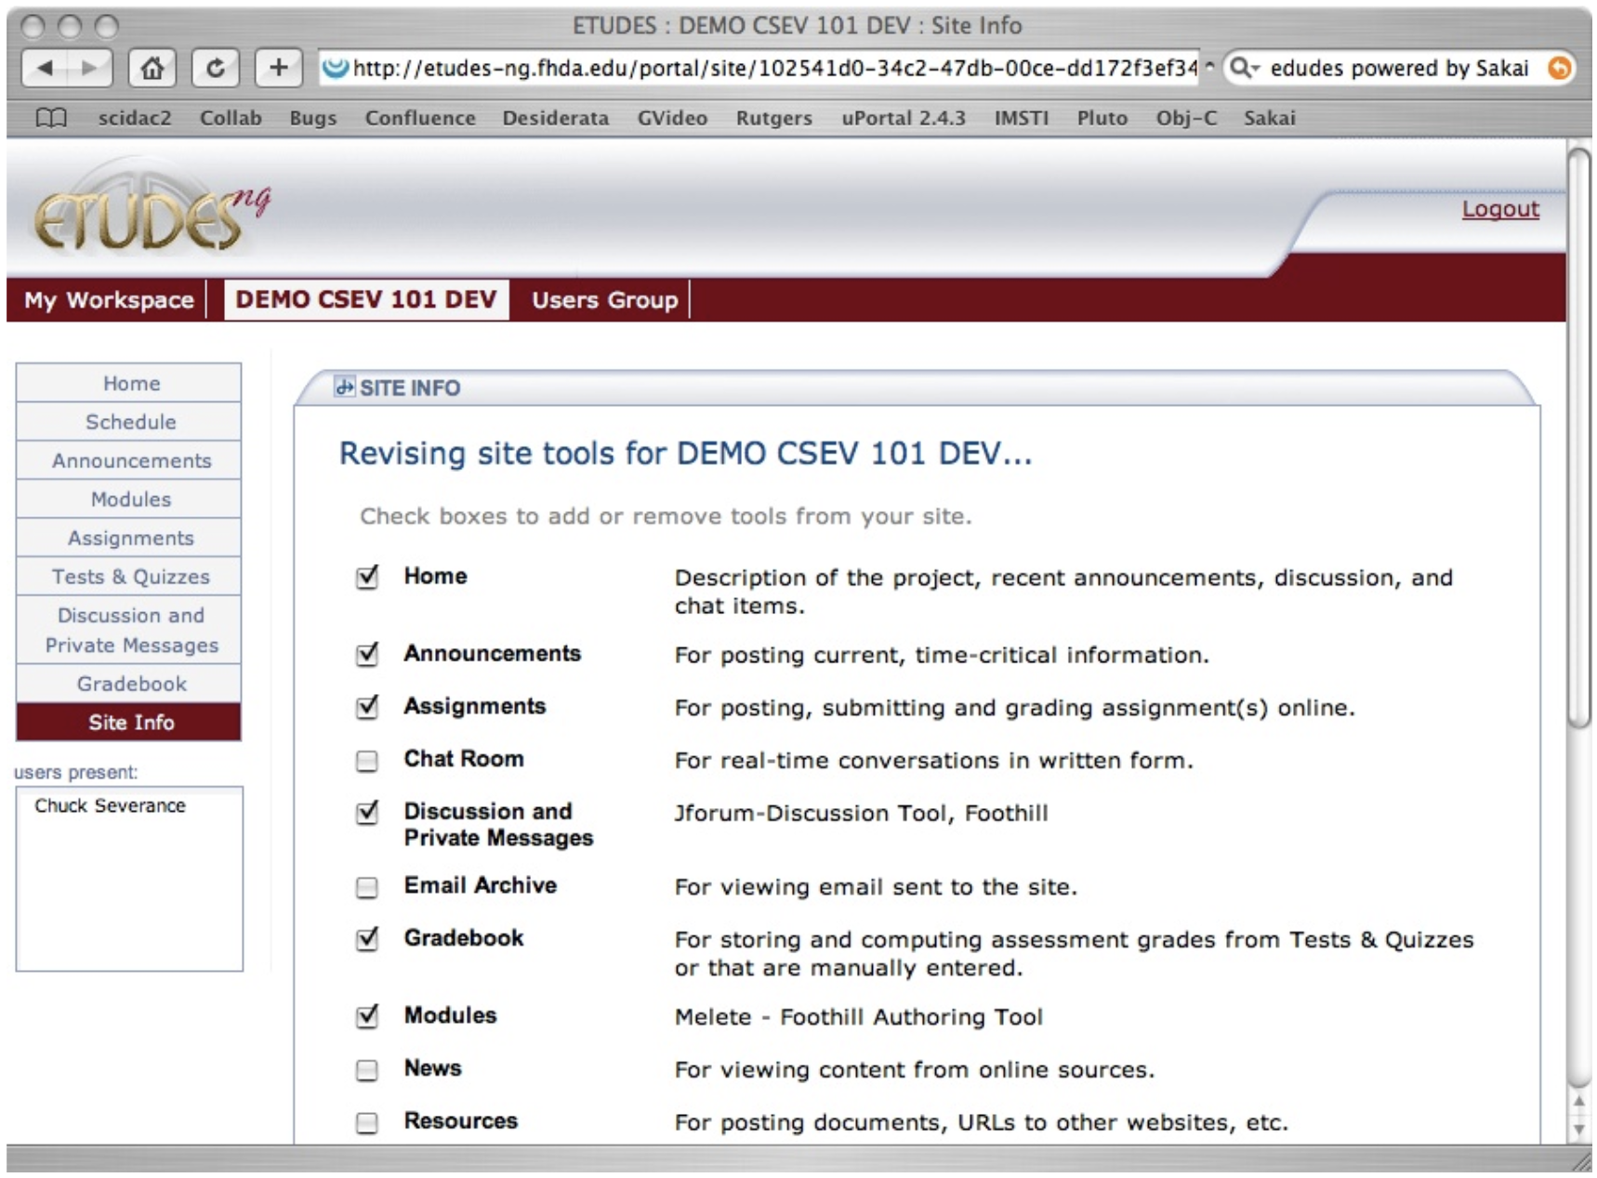

Slide 23
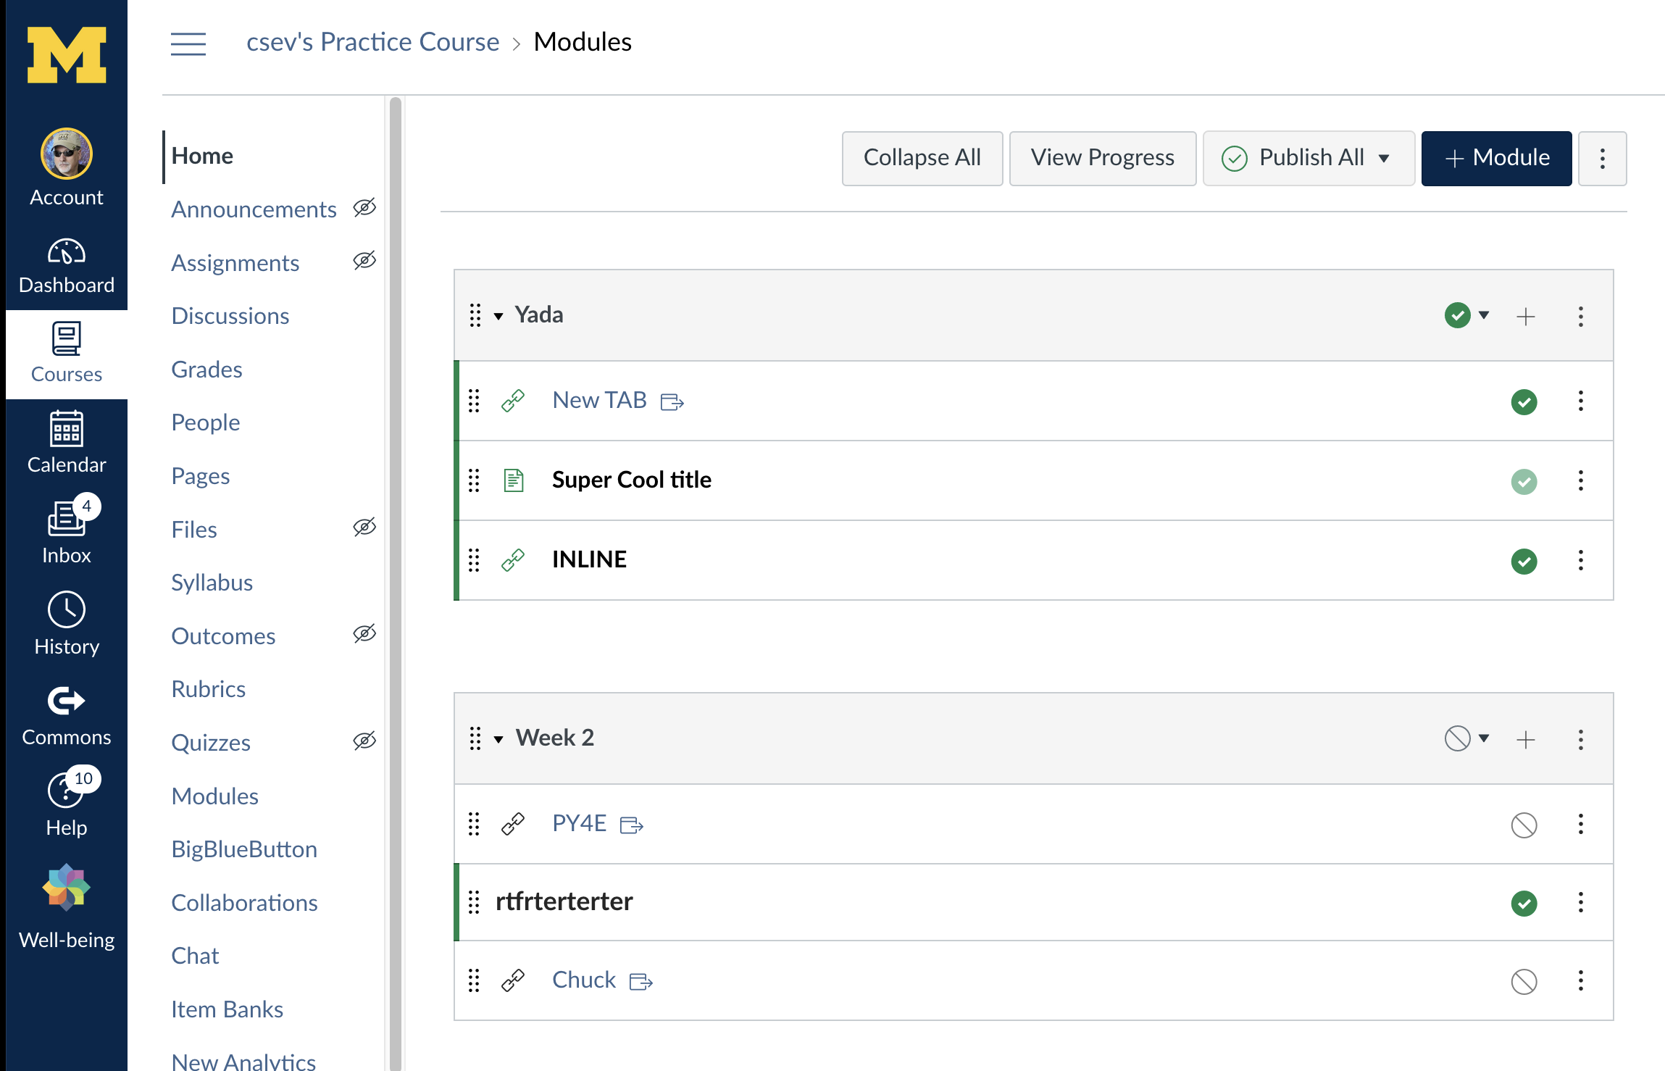

Slide 25
2008-2010 (The dark ages of Sakai)
Sakai 3 Spends Millions and a Year Three times and fails every time
The Sakai Foundation decides in 2009 to bill three years in advance for memberships and then spends that on Sakai
By 2010 – The Foundation has been bankrupted
The board members start funding Sakai 3 directly and give up their seats on the Foundation – they were replaced by people friendly to Sakai 2.x
Sakai 2.x continues to improve and be successful I production around the world

Slide 26
2011
The big Sakai schools reach deep for one more "grand rewrite of Sakai 3"
D2L releases LTI 1.1 – and then everyone implements LTI
Instructure launches Canvas based on LTI and Common Cartridge and simplified Sakai UI – it seemed small and insignificant in 2011 ☺
Sakai releases 2.8 – The first release that includes Lessons in core

Slide 27
2012
Sakai 3.0 Fails to deliver one last time and all the major funders publicly give up on the effort – some even want money back
In December 2012 – The Sakai Foundation shuts down and transfers all assets to the Apereo Foundation – Ian Dolphin is the new executive director
Sakai releases 2.9 - Cleanup and tighten up Sakai 2.8 (Lessons was a big deal)

Slide 28
2014
The founding Sakai school start Canvas pilots and would shut down their Sakai instances in 2016.
Canvas listened to the Sakai board in 2008
Sakai 2.x was clunky and lumpy and not pretty
Rewrite the software in a new framework – Ruby on Rails
From 08-12 there were numersous blog posts about Sakai 3 dreams
Sakai released Sakai 10 as evolution on Sakai 2.9

Slide 29
2016
The big founding schools complete their Canvas Pilot and begin to shut down their Sakai instances
The Open Academic Environment (fouth attempt at Sakai 3) team leave en masse when the other product they work buiding in secret was purchased by Blackboard (Ally)
Sakai moves to git, removes iframes, and releases Sakai 11

Slide 30
2016 - Present
Sakai starts the roadmap process to capture areas where improvement is needed (2019)
Pandemic starts (2020)
Oxford leaves for Canvas (2020)
NYU leaves for D2L (2021)
UCT leaves for D2L (2022)
Duke leaves for Canvas (2023)
Sakai releases versions 12, 19, 20, 21, 22, 23

Slide 31
Sakai 23
All new portal
Major rewrite of the grading service (grand unification)
SakaiPlus
Spanish universities and EDF invest heavily in improving UI and new features targeted towards Sakai 22 and then Sakai 24.

Slide 32
So Where Are We

Slide 33
Good News
Thanks to the Roadmap, our UI/UX/Feature Set is on par with our competitors
I know of no switch away from Sakai that was due to student of faculty dissatisfaction
IT leadership wanting to get off the Sakai train and delegate responsibility
Faculty coming from other schools that wanted to use the same thing as their other school

Slide 34
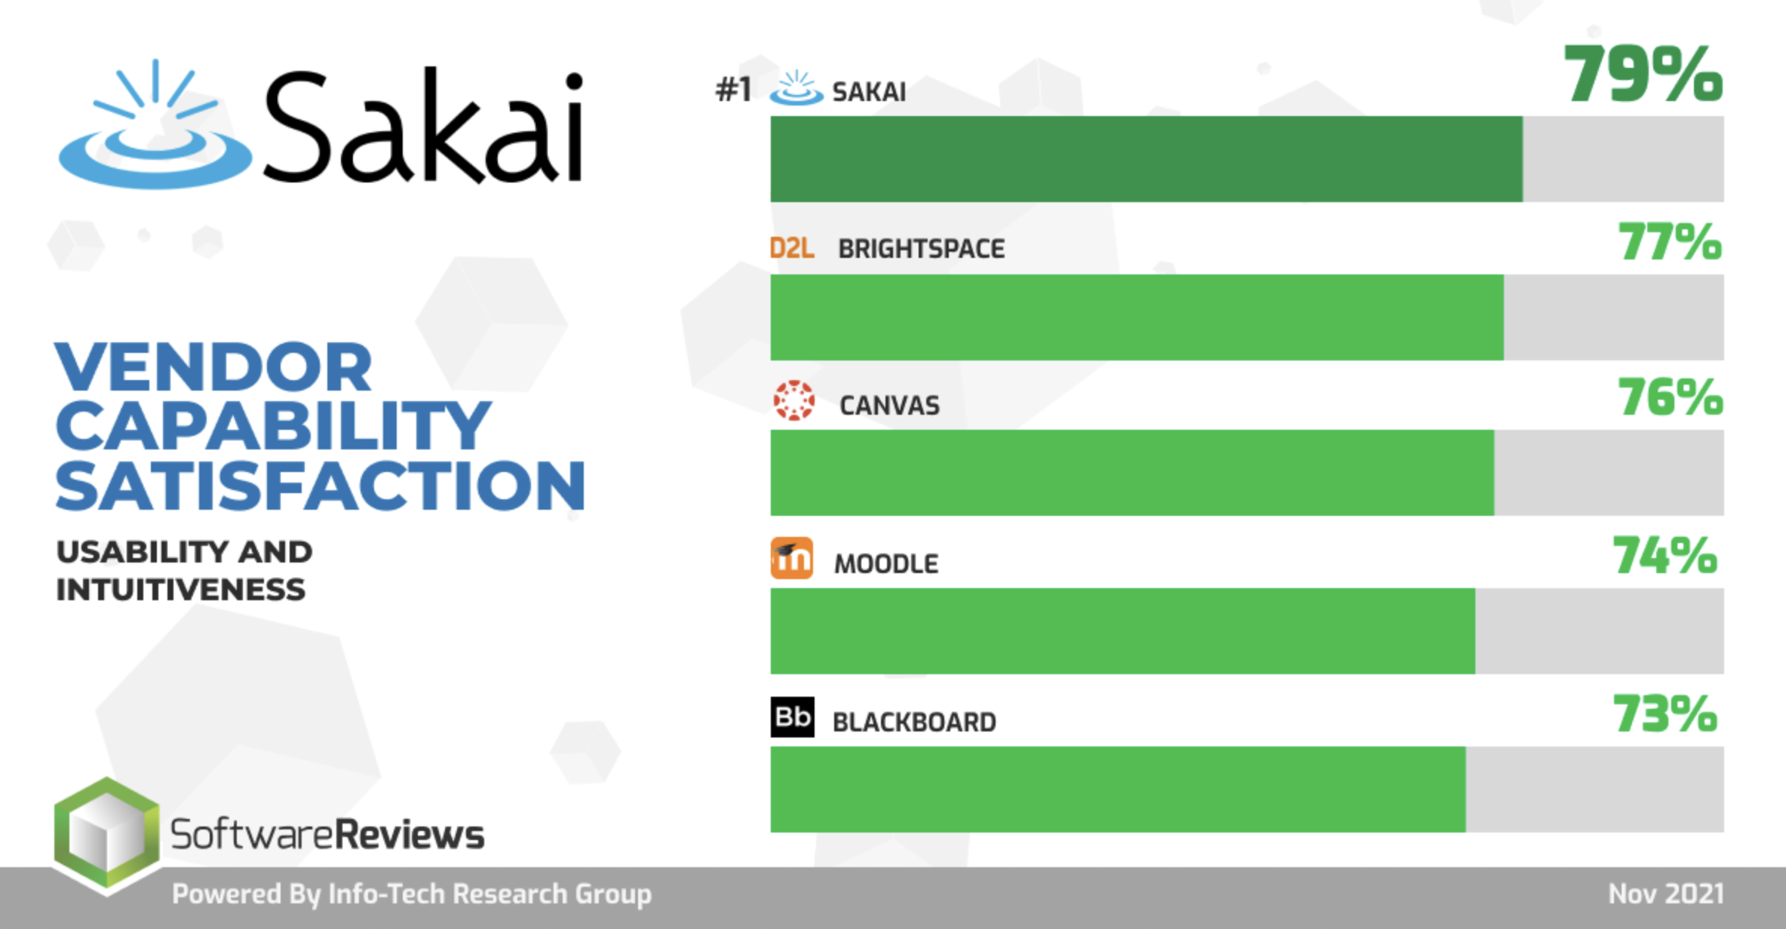

Slide 35
Bad News
Sakai is a hard-sell as the enterprise LMS for a medium to large campus
Large schools are moving away
Revenue into Longsight from those large schools is also dropping

Slide 36
Where to we go from here?

Slide 37
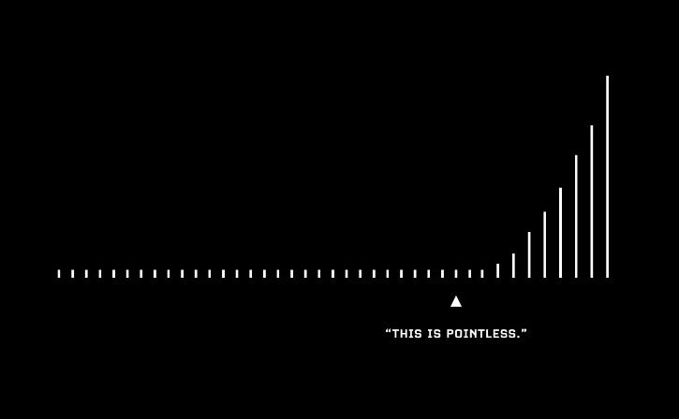

Slide 38
Two Problems to Solve
How to bring new schools into Sakai to fund the core development and community coordination?
Is there a unique opportunity to de-stagnate the market, now dominated by Canvas, D2L, and Blackboard?
All these systems are pretty close to what Blackboard had in 2002.
The only real change is who has market share
Is there an opportunity for something new that no one is seeing right now? Much like Canvas saw in 2008 and released in 2011 with growth in 2013 and on…

Slide 39
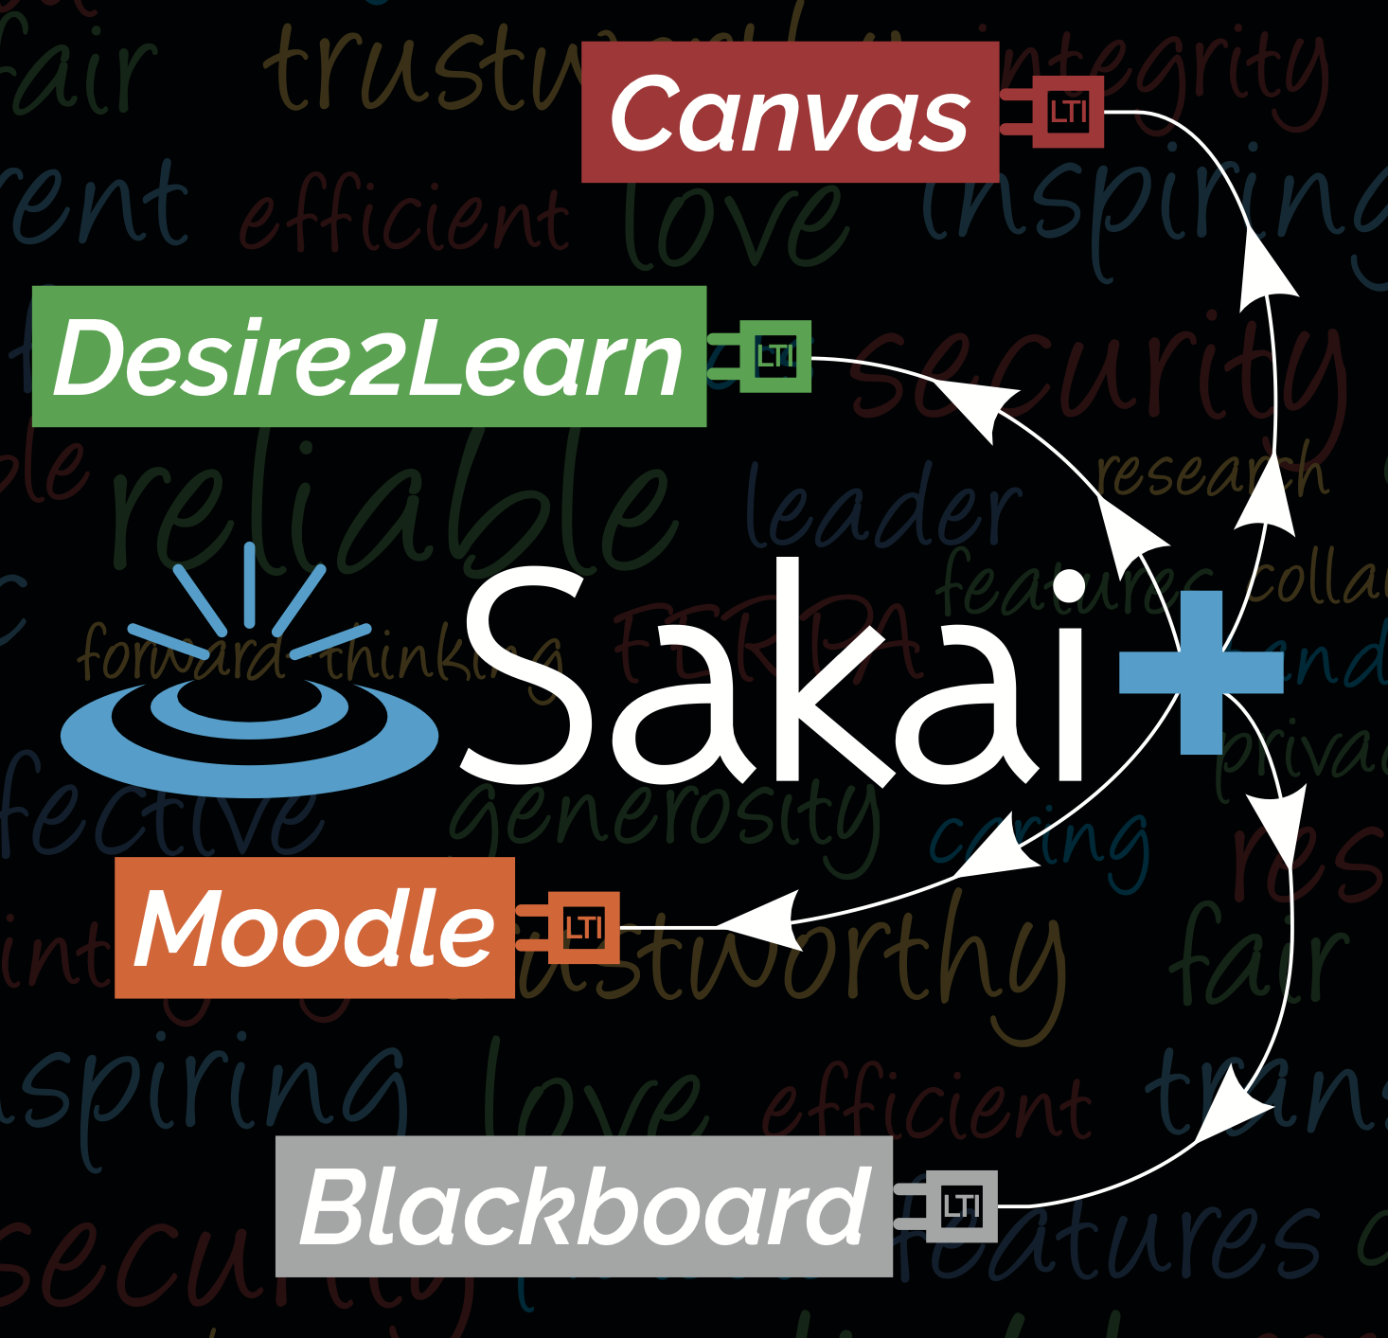
SakaiPlus
Part of Sakai 23
Pretty interesting to schools that never even used Sakai
Also interesting to schools transitioning off Sakai
Real multi-tenant hosting keeps costs of small instances really low
Can help sustain SakaiLMS as an Enterprise LMS for years if successful

Slide 40
Beyond SakaiPlus
????

Slide 41
What is an LMS?
Course Authoring – Common Cartridge
Enrollment Management - OneRoster
Course Management Runtime – LTI Advantage
Tool Orchestration – LTI
Roster Orchestration – Names and Roles
Grade Book – Outcomes
Course Tracking – Caliper / XAPI
Other things like Rubrics / Competencies and Academic Standards

Slide 42
If you were to build an LMS in 2024…
Standards would be at the core
The overall architecture / decomposition
The "internal design documents"
The web services
There would be a complete separation between UI/UX on the front end and service implementations on the back end
Progressive Web Application
Augmented Reality
Video Game Console
Television Application

Slide 43
Why Rewrites Fail or Take a Long Time
We start with a small team of 4-5 fresh, excited developers
Brand new tech stack – decided on at the first meeting of the five devs
Little awareness of the legacy product
Little awareness of the myriad of use cases that are represented un the legacy product
Are told to get back to basics and write a simple system with gradebook, files, quiz engine, and a threaded discussion
Don't talk to any teachers or instructional designers
We give you 12 months
We talk up the new project and kind of ignore the legacy project

Slide 44
The History of LMS Rewrites
WebCT Vista – Killed the company
Blackboard Learn – Took far longer than expected, eventually they invested enough in Blackboard Basic to bridge the gap
Sakai 3.0 – Pitched the code and restarted with a new team and leadership – four times! Pitched the tech stack a few times.
Canvas – Took 4 years with a 2 year friendly customer beta period
Blackboard Ultra – Took a break, slowed down, kept legacy in place, focused on moving to the cloud and getting rid of Oracle, regret the choice of Angular

Slide 45
What if…
We had a team of 10 developers deeply connected to a community of teachers , instructional designers, and students
Experts in developing a production / scalable LMS
Experience in choosing new tech stacks and then living with that choice years later
Experienced in the complexity required in a new LMS
Able to continuously bring new ideas from the rewrite back to the legacy LMS and put them into production with real users
And we gave them 3-5 years
We learn from the mistakes of WebCT Vista, Sakai 3.0, Blackboard Learn, Blackboard Ultra and emulate the success of Canvas

Slide 46
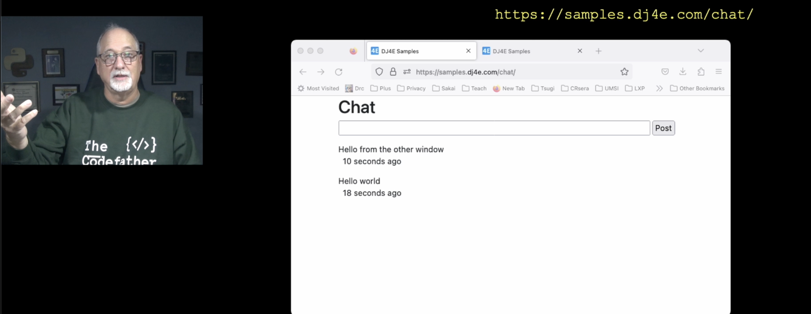
As a Teacher…
I use many LMS's
Canvas
Sakai
Tsugi
Coursera
edX

Slide 47
As a Teacher…
I use many LMS's
Canvas
Sakai
Tsugi
Coursera
edX
I don't like any of them particularly well (5/10)

Slide 48
As a Teacher…
I use many LMS's
Canvas
Sakai
Tsugi
Coursera
edX
I don't like any of them particularly well (5/10)
But the superset of the ideas *across* all these systems in a smooth, well integrated set of components would change my teaching forever

Slide 49

We are at a unique moment in time…

Slide 50
Questions…
Up next, we go into a closed session with the local attendees and Sakai PMC members
SWOT in the marketplace
More detail on the idea of a rewrite
Ways to fund this crazy idea

